Slide 1
Agile Development
Stephen Joe Cruz
DEV-COR Deputy Team Leader / Associate Software Developer
Cris Ann Rioflorido
DEV-COL Team Leader / Software Developer

Slide 2
Agile Manifesto
We are uncovering better ways of developing software by doing it and helping others do it. Through this work, we have come to value:
Individuals and interactions over processes and tools
Working software over comprehensive documentation
Customer collaboration over contract negotiation
Responding to change over following a plan
That is, while there is value in the items on the right, we value the items on the left more.

Slide 3
The principles of agile methods
Principle | Description
Customer involvement | Customers should be closely involved throughout the development process. Their role is provide and prioritize new system requirements, and to evaluate the iterations of the system.
Incremental delivery | The software is developed in increments with the customer specifying the requirements to be included in each increment.
People not process | The skills of the development team should be recognized and exploited. Team members should be left to develop their own ways of working without prescriptive processes.
Embrace change | Expect the system requirements to change and so design the system to accommodate these changes.
Maintain simplicity | Focus on simplicity in both the software being developed and in the development process. Wherever possible, actively work to eliminate complexity in the system.

Slide 4
Version control
This is the management of changes to all files involved in development, including but not limited to:
source codes
scripts
documentations
Examples of version control systems are:
CVS (Concurrent Versioning System)
SVN (Subversion)
Git (Either Github or Gitlab)
Notes:
Next slides will consist of screenshots for the different version control systems, starting with CVS.

Slide 5
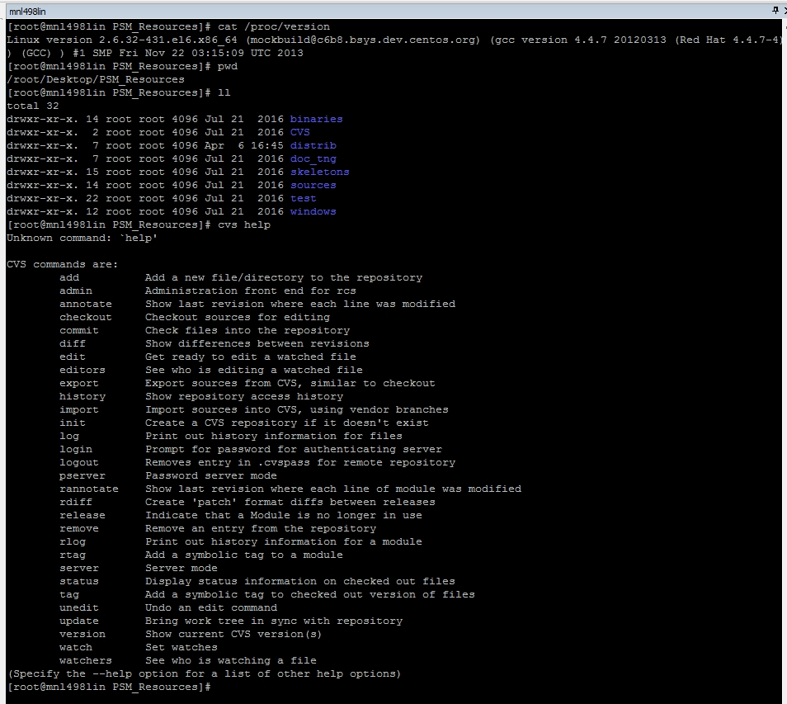
CVS commands screenshot from a Linux terminal, accessed through MtPuTTY SSH
Notes:
Next slide will be SVN commands screenshot.

Slide 6
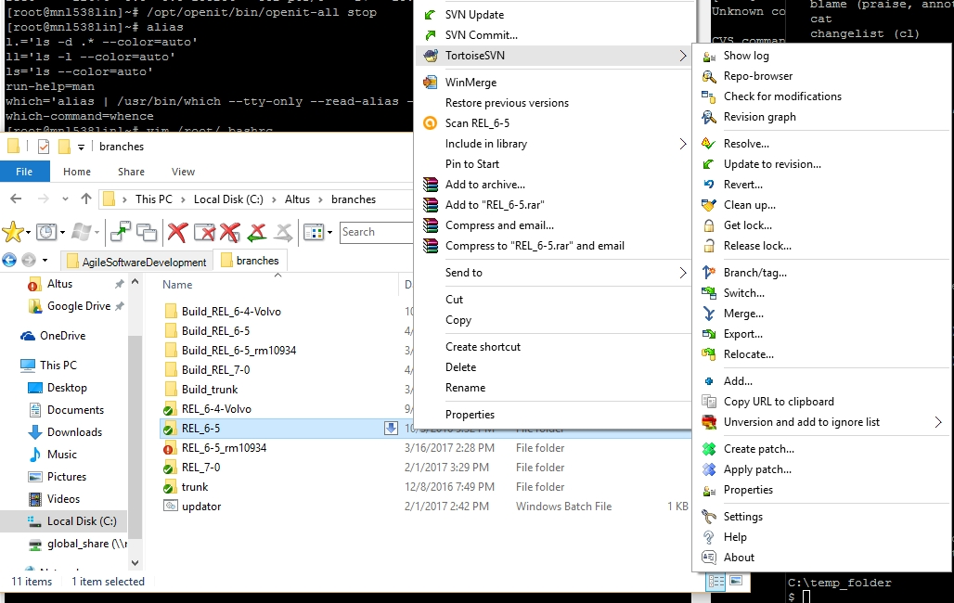
SVN commands screenshot from Windows file explorer, where TortoiseSVN is integrated in the context menu
Notes:
Next slide will be SVN logs screenshot.

Slide 7
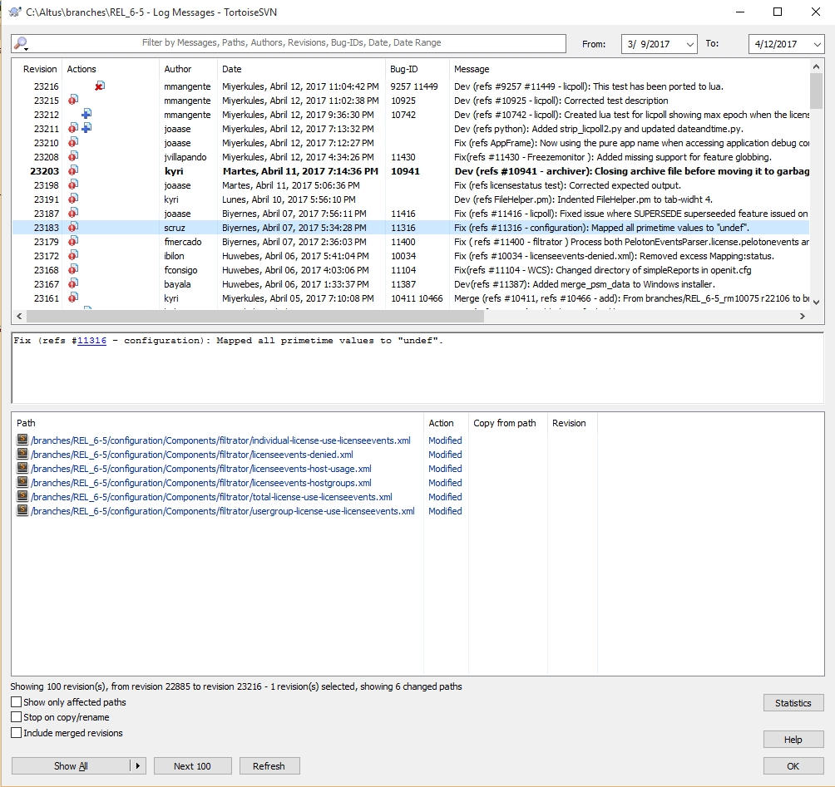
SVN logs screenshot, seen after clicking the “Show logs” command from the TortoiseSVN context menu
Notes:
Next slide will be screenshot of Git bash.

Slide 8
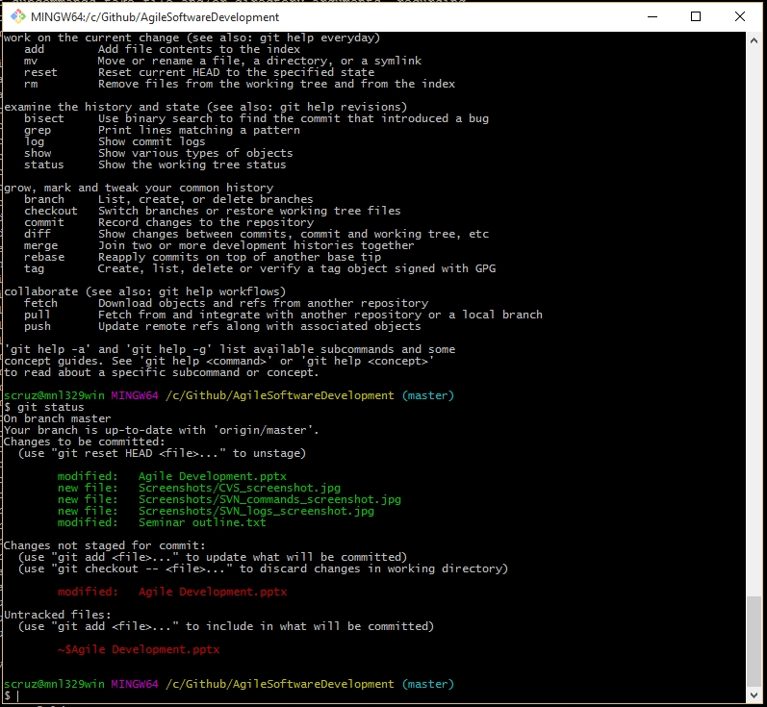
Git bash screenshot; current directory is inside the cloned repository’s local working copy
Notes:
Next slide will be common commands in version control systems and what they do.

Slide 9
Frequently used version control systems’ commands (using the CLI):
To obtain a working copy of the repository:
CVS and SVN -> checkout <URL of repository>
Example -> svn checkout http://svn/repos/altus/branches/REL_6-5
Git -> clone <URL of repository>
Example -> git clone https://github.com/joeypencil/Joeyjava.git
To check logs of revisions:
CVS and SVN -> log <branch> [--limit <number of revisions>]
Example -> svn log REL_6-5 --limit 3
Git -> log [-<number of revisions>]
Example -> git log -5
To commit your changes from the local working copy to the repository:
CVS, SVN and Git -> commit –m “<Commit message here>” [specific files, for selective commit only]
Example -> svn commit –m “Fixed regex for validation”
Notes:
Next slide is continuation of commands.

Slide 10
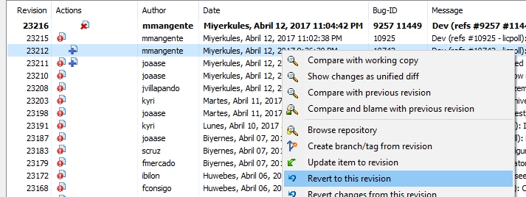
When merging changes from one branch to another, it is better to use a diff software to merge the differences easily, rather than using the CLI. This also goes for reverting to an older revision.
To update your working copy:
CVS and SVN -> update <branch>
Example -> svn update REL_7-0
Git -> pull
Example -> git pull

